Slide 1
Intelligent Content Aggregator And Knowledge Synthesizer
By
E.Manjith
P.Hotragn
V.Srinath
Mentor: Dr.Kiran Kumar Ravulakollu

Slide 2
AGENDA
Problem Statement
Background and Introduction
Literature Review
Use Case
Architecture Diagram
Methodology
Preliminary Results
Expected Outcomes
TimeLine
References

Slide 3
Problem Statement
Students are facing a significant challenge in the current landscape of information retrieval. Reading articles and research papers takes a lot of time, and we often find that the content doesn't meet our research needs. This inefficiency is frustrating, as it consumes valuable time without yielding satisfactory results.
Moreover, the vast amount of information available on the internet poses a challenge for efficient and effective knowledge extraction. Therefore, we propose a project aimed at extending web capabilities to address this issue. The project involves extracting information from all visited websites and providing summaries of the content.
In many cases, valuable information is embedded in images and diagrams within articles. Thus, it's crucial to explore solutions that go beyond text-based content extraction to ensure comprehensive knowledge retrieval.

Slide 4

Background And Introduction
As browsing has become a daily routine, the time a person takes to analyze through multiple websites at a single shot and understand them is difficult. These findings had become tough while correlating the content from multiple websites which is leading to ambiguity in human brains.
Motivated by this, this project will focus on correlation between the information from various pages and formats. There are endless extensions like copy fish and vowel ai which can extract text or summarize wrt the feature of extension. Yet there's a lot of complications for us as humans to compare and thereby conclude a single concept.
Collective analysis of a single topic from various written styles would help users to increase productivity and management in terms of time invested. We will be having a single extension that can extract data from multiple active tabs with the utmost experience to users,which will improve their performance and work.

Slide 5

Literature Review [1]
An extension that has developed to help the users with poor English using the python dictionaries, google cloud firebase, and flask. This extension will generate pre-defined difficult words based on an article/website by parsing the content.
With the information extracted, it will map the definition of words generated to a dictionary and check if the extension is able to accurately generate the words.
In addition, this extension will have a track of the most difficult words for users and use this information for future users to have a seamless experience.
In conclusion, this extension provides a simple understanding of difficult words to users in english.

Slide 6
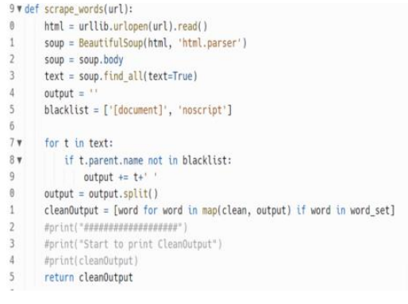
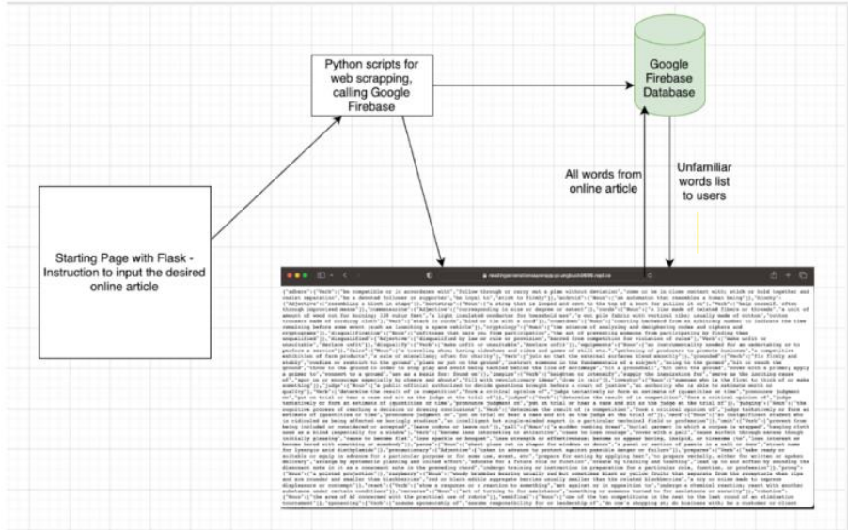

Slide 7
Literature Review [2]
The Maxai extension has a variety of features that uses the most versions of ChatGPT and provides results for the user.
It helps in summarizing a text from a single page, Generating the content for email, and even as an assistant chatbot.
It works as an assistant and uses the ChatGPT 4 to produce results only with premium plan whereas the free plan only provides limited ChatGPT usage per day, and mini menu for a text selected.

Slide 8
Literature Review [3]
Given any prompt with the webaccess, the extension can give a response based on the latest news in ChatGPT. It can even scrape data from a URL by restricting responses to a specific URL and giving responses respectively.
It can perform a one-click prompts wrt required language, Tone, Writing style and Topic for a specific selected article/website.
There are many extensions that can replicate the same usage, but the mentioned extensions are the popular ones with most users.
Yet, all of these extensions are dedicated to specific URL/article/information. Through this project, we aim to develop an extension with features that enables it to summarize text from multiple writing styles provided.

Slide 9
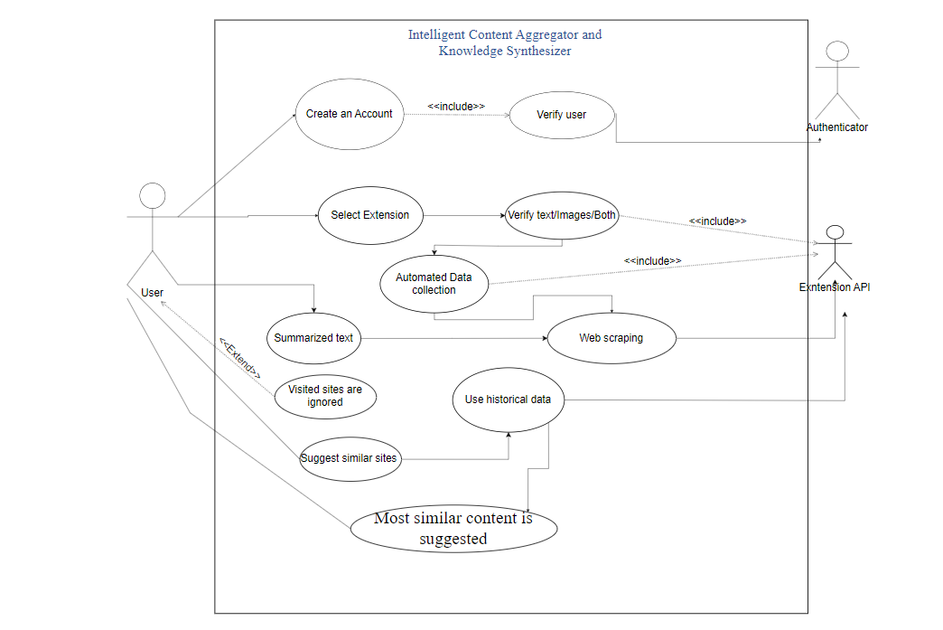
USE CASE

Slide 10
Objectives
Help users to gather and summarize information automatically from visited websites.
Extract text from Images using OCR and combine with other information.
Minimal time to Research and site suggestions.
Overcome Challenges: Redundancy, Multilingual text

Slide 11
Novelty
Integrating Various technologies such as web scraping through extension and summarizing the extracting content with a ML model.
Analyzing the content inside a HTML page based on tags and context present in those tags

Slide 12
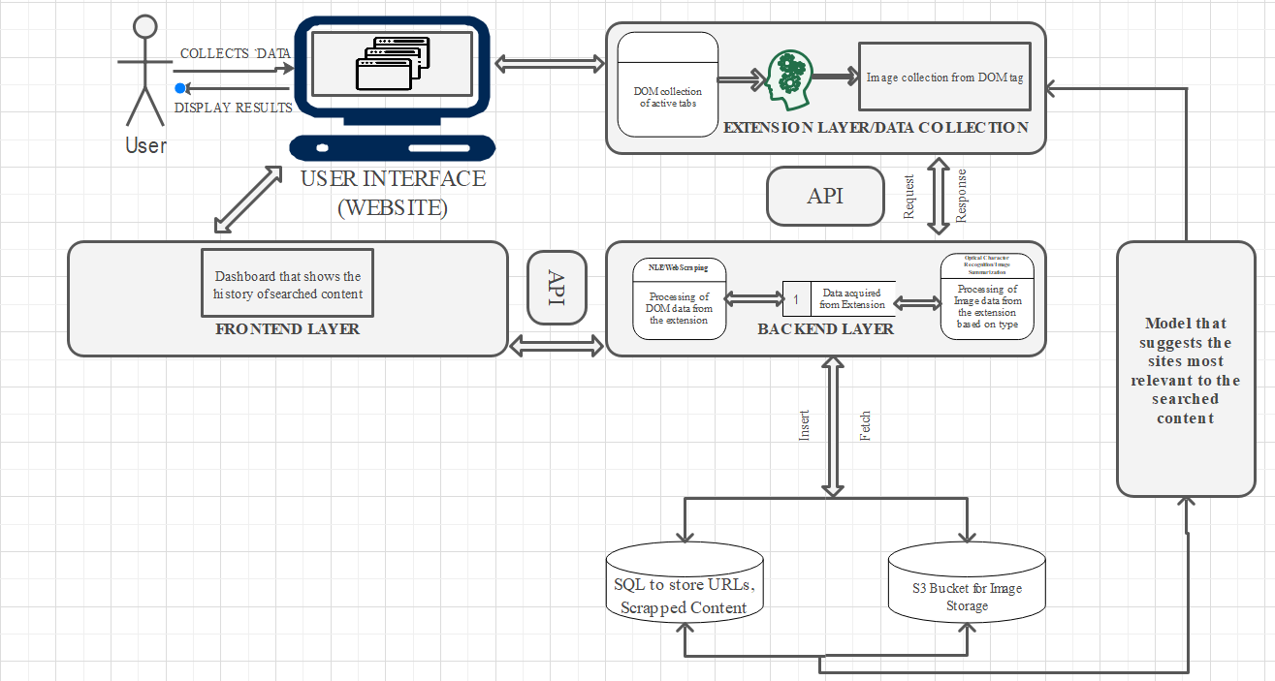
Architecture Diagram

Slide 13
Methodology
DOM Elements from the visited pages will be collected through extension which will be built using JavaScript. Once the DOM content is accessed it will be sent to the backend using an api. image tags will be extracted separately and will be sent to the backend in the form of URL or file format.
Rule Based Extraction
Based on some pre-defined rules specific containers or div’s will be avoided because they may contain information irrelevant to the searched information like ads. but all websites will not be following the same structure so the following step will try and eliminate such content
Model Based Extraction
As all websites do not follow the same structure, we try eliminating most of the unused content in the first step. We will try and build a machine learning model which should be able to separate tags based on their content.

Slide 14
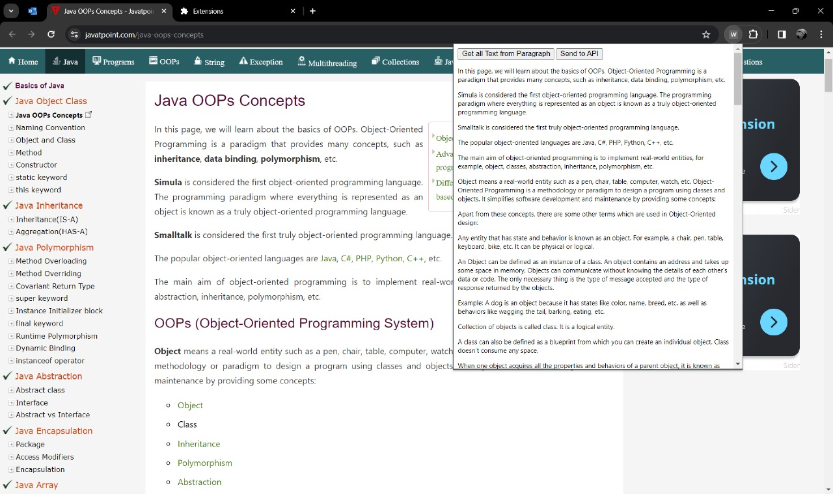
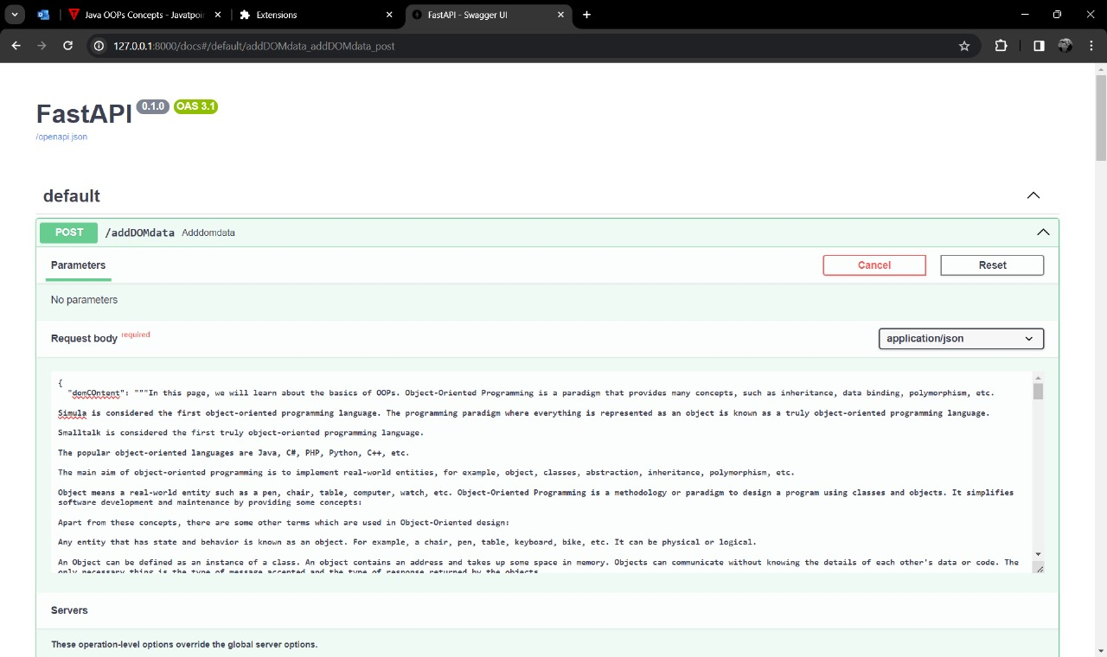
Preliminary Results

Slide 15
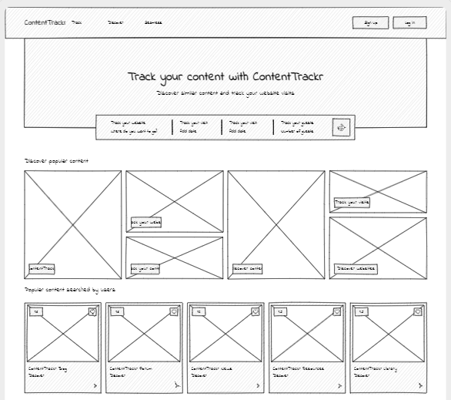
UI DESIGN

Slide 16
Expected Outcomes
Copy right registration
Chrome Extension
Platform for management of researched content

Slide 17
Timeline | Manjith | Hotragn | Srinath
Jan 1st – Jan 15th | Literature, proposal. | Literature, proposal. | Literature, proposal.
Jan 15th – Jan 31st | Preliminary Results | Preliminary Results | Preliminary Results
Feb 2nd - Feb 20th | Modal test and research/ train and error | Rule definition for tag-based extraction | Data Based design And data collection
Feb 21st – Feb 29th | Api Architecture design | Frontend design and development | Integration
Mar 1st – Mar 15th | Testing | Fine Tuning | deployment

Slide 18
References
[1] Zhao, Tongde, and Khoa Tran. "APowerful CHROME EXTENSION: TRANSLATION PROGRAM USING PYTHON, WEBSITE ANALYSIS AND GOOGLE FIREBASE SERVICES." CS & IT Conference Proceedings. Vol. 13. No. 7. CS & IT Conference Proceedings, 2023.
[2] https://maxai.me/
[3] https://chromewebstore.google.com/detail/webchatgpt-chatgpt-with-i/lpfemeioodjbpieminkklglpmhlngfcn

